Slide 1
COMP 3617
Week 1

Slide 2
COMP 3617
Android and Mobile Applications in Java
Uses Android Studio based development environment for building Android apps
Makes use of Emulator for development in class

Slide 3
Pre-requisites
Required
Experience with Java
Familiarity with Object Oriented Concepts
Good to have
Experience with Java EE
Caveat: If you are totally new to Java programming, consider taking one of the pre-requisite courses before taking this course

Slide 4
Instructor
Krishna K
Email via D2L

Slide 5
Today’s Outline
Introduction to COMP 3617
Android History
Setting up the Android Studio
Introduction to Android SDK Manager
Setting up an Android Platform
HAXM
Introduction to Android Virtual Device Manager
Setting up an Android Virtual Device

Slide 6
Nature of the course
Introductory in nature
More breadth then depth
Broad coverage of the Android platform – not just limited to User Interface
Lego like – demonstration of various components and building blocks in class. You put these together to build applications as part of assignments and final project

Slide 7
Nature of the course
Your participation in assignments and Final Project is a must – if you are not keen on this, you should either audit the course or reconsider

Slide 8
Java Knowledge Expectations
Experience with Inner classes and Anonymous classes in Java
Feel comfortable developing in an IDE based environment
Familiarity with Threading concepts in JDK
Familiarity with a few JEE concepts
Working knowledge of JSON
Basic Knowledge of HTTP API in JDK
Knowledge of XML APIs in JDK

Slide 9
Challenges of Android Development
Fragmentation – 10K+ unique Android devices with only more to come
Devices with different screen sizes, capabilities and densities
iOS does not have to deal with the above two scenarios as Apple controls the hardware
Emulators are slow but getting better
iOS uses simulators instead of emulators, so provides a better development experience
Rapid releases of the platform

Slide 10
What to expect
Inquisitiveness to explore and learn new things on your own
Hands on programming course – you have to feel comfortable writing Java code (say 100 lines in some demos in the class) in an IDE environment alongside the instructor

Slide 11
What to expect
Ability to allocate time and work on the final project between week 6 to 11
Above all have fun in the course by trying to build an app of interest to you and educate your fellow students how you built the design and implementation of your app

Slide 12
This course is not…
A course to learn Java Programming
About making an experienced Android developer become an App millionaire
About game programming
About making an experienced Android Programmer become an expert. If you already an Android Programmer, this course might not add much more to your knowledge

Slide 13
Marking Guide
Assignments (30 %) – 3 Assignments to be done individually
Midterm (30 %) – Written exam
Final Project (40% ) - More on this on week 6
(Must complete final project successfully to pass the course)
You need 60% to pass the course

Slide 14
Attendance
BCIT policy requires 90% attendance in the course (means you can miss at most 2 classes in the course)
Send an email to the instructor if you cannot make it to a class
Missing the final project would earn an “F” (Failed) for the course

Slide 15
Text Book
Required Text book
Head First Android Development by Oreilly Publications
Reference Books
Android Programming – The Big Nerd Ranch guide

Slide 16
Software Requirements in class
JDK 1.7 (64-bit)
Android Studio
Course assumes Windows as the development platform.

Slide 17
Software for the class
The two software downloads (64-bit versions) are available on J:\COMP\3617\2016 accessible to BCIT workstations. You can copy them and install them on your home machines
For instructions on how to access them from home, click here (or see the URL in the notes)
If your machines are 32-bit, you can download and install the 32-bit versions of the same
Notes:
Here is URL http://kb.bcit.ca/sr/network/734.html to access the BCIT Share OUT (J:\COMP\3617\2016)

Slide 18
Mac Users
If you are using Mac, it is expected that you are knowledgeable with the Terminal and are comfortable using the common command line tools
You are responsible for finding the equivalent short cut keys in Android (a keyboard shortcut cheat sheet will be provided for Mac and Windows environments)

Slide 19
Software Consistency
It is important that all of you use the same version of Android Studio as is installed in the classroom – no exceptions
If you submit versions of Android Studio projects that cannot be opened with the Android Studio installation in the classroom, then your assignments/project will not be graded and you will lose points

Slide 20
Hardware Requirements
We will only be using Android Emulator in the class
Assignments will be tested on the emulator
Sadly Android emulators are terribly slow
Emulators can be sped up by choosing x86 Android images rather than ARM images
Software from Intel (HAXM) speeds up the emulator (we will be using this in class)
Without HAXM it is painfully slow

Slide 21
Hardware Requirements
Certain features (Eg: Google Maps) of Android can only be tested on a device
If your final Project requires a device, you are welcome to bring your own for the demo
If you have a device that you would like to use in class, you are welcome to do so – but you are responsible for setting it up by going through the documentation provided by your device’s vendor
Notes:
For more information on
http://developer.android.com/tools/device.html
http://developer.android.com/tools/extras/oem-usb.html

Slide 22
Setting up a device
Here is the link to setting up a device for development
http://developer.android.com/tools/device.html

Slide 23
Web Resources
P/T Computing Studies Website:
http://www.bcit.ca/cas/computingparttime/
Student Guide:
http://www.bcit.ca/files/cas/computingparttime/pdf/computingparttime_student_guide.pdf
Student resources:
http://www.bcit.ca/its/student/
BCIT Bookstore
http://www.bcit.ca/bookstore
Course Syllabus
http://www.bcit.ca/study/outlines/index.shtml

Slide 24
Class Resources
Available via D2L (Desire to Learn) web site http://learn.bcit.ca (Can be accessed remotely)
For any submissions (Assignments/Project) use D2L. There will be dropbox folders for each required submission
Use zip files for any submissions. No other compression formats will be accepted
Set a forwarding address in D2L to your personal email otherwise any emails from me will not reach you unless you login to D2L

Slide 25
Student Resources
Home Directory (H:\)
Accessible to all students logged into BCIT workstations
Your exclusive storage on the network
Don’t run anything off this drive as it would be really slow
Data will be available through out the semester
BCIT Machines get re-imaged regularly – so don’t save your projects on C: or D: for future access

Slide 26
Deep Freeze on the workstations
PCs in this classroom are protected by software known as Deep Freeze
The software reimages the machines every week, which means you cannot save something to the disks C: and D: and except it to be available the following week
H: is your personal storage and is not affected by this. But this is a network share, so don’t run the software from here as it will be slow

Slide 27
Deep Freeze on the workstations
Since Android Studio configuration is done after the installation, BCIT has actually installed and configured all the machines
This is the first time that the course is conducted with this limitation
So this presents some unanticipated challenges for me – so your patience, when we run into issues due this, is appreciated

Slide 28
Android History
Android OS was developed by Android Inc
Google acquired Android Inc in 2005
Open Handset Alliance (OHA) was formed in 2007 that owns the Android Open Source Project (AOSP)
OHA includes Semiconductor (ARM, Nvidia,…), Hardware (Samsung, HTC, LG,…), Software (Google) and Carriers (T-Mobile, Sprint) – about 80+ companies
Google is the main contributor and driver of Android in the OHA group
First Android version was released in 2008

Slide 29
Android History
By 2010 Android became number one platforms for Smart Phones
2011 saw the beginning of the tablet market
2012 -Google TV (obsolete now)
2013 – Wearables
2014 – Android TV, Auto
2015/2016 – ??? iOT (Google’s Ubiquity)
Notes:
Check out
http://www.businessweek.com/articles/2013-05-29/behind-the-internet-of-things-is-android-and-its-everywhere

Slide 30
Android Versions
Android Version | Codename | API Level
1.0 | Apple Pie | 1
1.1 | Petit Four/Banana Bread | 2
1.5 | Cupcake | 3
1.6 | Donut | 4
2.0, 2.01, 2.1 | Éclair | 5, 6, 7
2.2 | Froyo | 8
2.2, 2.3.3 | Gingerbread | 9, 10
3.0, 3.1, 3.2 | Honeycomb | 11, 12, 13
4.0, 4.0.3 | Ice Cream Sandwich | 14, 15
4.1, 4.2, 4.3 | Jelly Bean | 16, 17, 18
4.4 | Kitkat | 19
5.0 - 5.1.x | Lollipop | 20, 21, 22
6.0 | Marshmallow | 23
Each new version is named after a dessert in an alphabetical order
Notes:
1.0 – Apple Pie?
1.1 – Banana Bread?

Slide 31
Android Versions
Android Version | Description
Android 2.3 (Gingerbread) | Released in Dec 2010. Main features include support for near-field communication (NFC), better navigation capabilities, increased power efficiency
Android 3.0 (Honeycomb) | Released in Feb 2011. Tablet only release. Main features include fragments, action bar, holographic look and feel
Android 4.0 (Ice Cream Sandwich) | Released in Oct 2011. Merges mobile and tablet versions into a single version
Android 4.1-4.3 (Jelly Bean) | Released in July 2012. Features include support for external displays, improved security
Android 4.4 (KitKat) | Released in Oct 2013. Features include performance improvements, improved graphics and multi-media capabilities
Android 5 (Lollipop) | Material Design, Notifications on lock screen, new Camera API, OpenGL ES 3.0
Android 6 (Marshmallow) | New permissions model, Doze and App standby
Notes:
Every version adds new API capabilities – those are not shown here

Slide 32
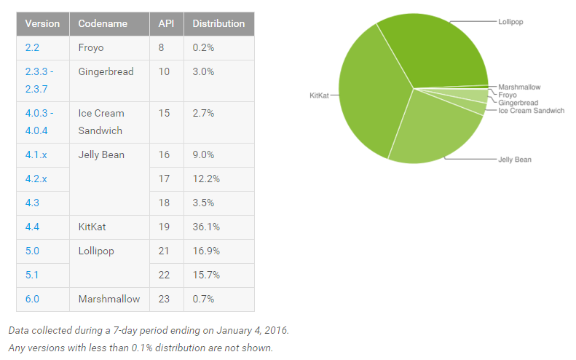
Android Platforms Marketshare
http://developer.android.com/about/dashboards/index.html
Android 4.x and greater have 75%+ 80%+ 90+ 95+ market share
Notes:
http://developer.android.com/about/dashboards/index.html

Slide 33


Android Customization
Google releases new Android version
OEMs add device drivers and other customization
Carriers add their specific apps
Your Phone

Slide 34
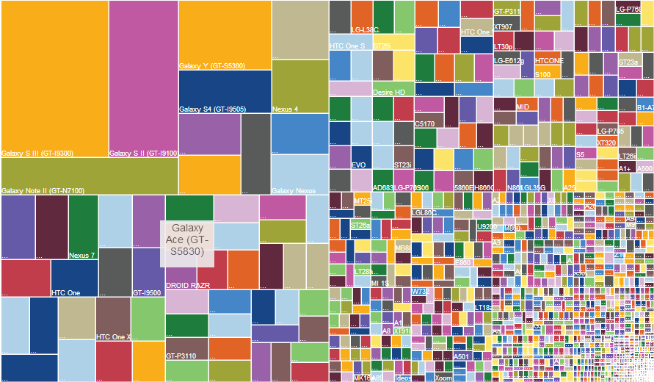
Android Fragmentation
As of 2013 this infographic represents the fragmentation of Android devices
Notes:
http://opensignal.com/reports/fragmentation-2013/

Slide 35
Certain assumptions about the Course
Focus primarily on newer versions of Android Platform (4.0 and above)
Main focus will be mobile development (very little emphasis on Tablets)
When applicable we will discuss the Android Support package which is important if you want to target older devices (pre Android 4.0)
No Gaming related APIs (OpenGL ES, renderscript) and capabilities will be discussed in the course

Slide 36
Android & Linux connection
Android is built on Linux kernel
Portability - Linux can run on many different types of hardware (ARM, x86, MIPS), hence the ideal choice for Android
Security – Android relies on Linux for security. Each Android application runs as a separate Linux process with the permissions provided by Linux system

Slide 37
Android & Linux connection
Android leverages great many capabilities of the Linux platform like memory management, networking etc
Android adds capabilities that are not available in the Linux platform – Binder, Wakelocks

Slide 38
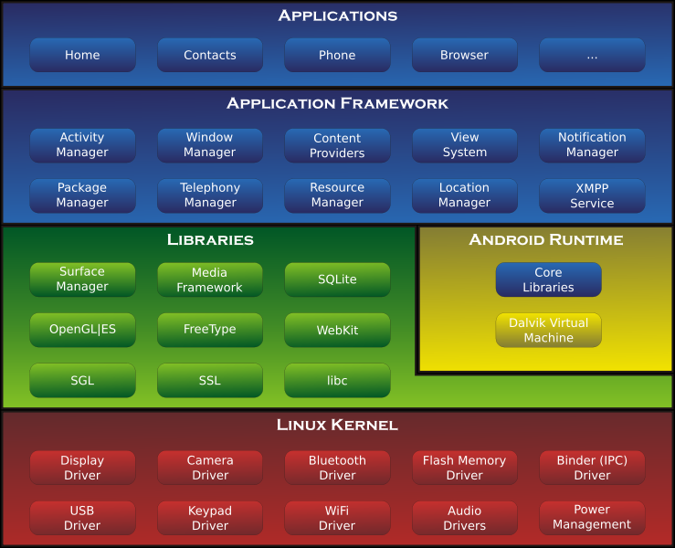
Android Architecture

Slide 39
Android Stack
Android platform can be broadly broken into five pieces
Apps
Application Frameworks
Native Libraries
Android Runtime
Linux Kernel

Slide 40
Application Framework
Provide developers the capability and tools to create rich apps for users and targeted to be deployed via Google Play Store
Developers have access to the same APIs that are used in the core applications
Libraries and system services
Android classes live in android.* packages
Access to standard Java libraries
Documentation is available at http://developer.android.com/reference/packages.html

Slide 41
Native Layer
Android has a rich native layer – compiled and preinstalled C/C++ libraries
Consists of HAL, native libraries, daemons and tools
HAL – (Hardware Abstraction Layer) standardized interface to Device Drivers to allow OEM specific drivers to be pluggable
Native Libraries – C/C++ Libraries Eg: SQLite, Apache Harmony, OpenSSL, WebKit, Binder, etc
Daemons support system services

Slide 42
Android Runtime (ART)
Same level as the Native libraries
Made up of two components
Core Java Libraries
Dalvik Virtual Machine/ART
You can think of Dalvik as an implementation of the JVM for mobile devices
There are significant differences between a JVM for Desktop/Server and Dalvik
A new runtime called ART was added in Kitkat and later

Slide 43
Dalvik Virtual Machine
Java compiles to byte code
Android does not execute Java byte code
Instead the byte code is converted to dex code to be executed by Dalvik VM
Android does not run Java VM but instead runs a specialized VM called Dalvik (for both technical and legal reasons)
Dalvik executes dex code (just like a Java VM on the desktop that executes bytecode)
Notes:
Dalvik – a register based machine vs stack based machine

Slide 44
Android Runtime (ART)
ART replaces Dalvik Virtual Machine
Dalvik uses just-in-time (JIT) compilation to compile bytecode everytime an app is launched
ART uses ahead-of-time compilation upon installation of an application thereby reducing the number of times an app is compiled
ART improves battery runtime as processor usage is reduced

Slide 45
Dalvik vs ART
 | Dalvik | ART
Compile Time | Just in Time (JIT) | Ahead-of-time (AOT)
Installation Time | Faster | Slow due to compilation
App Launch Time | Slower due to JIT compilation and interpretation | Comparatively faster
Storage factor | Comparatively smaller | Larger because of precompiled binary
Memory footprint | Larger due to JIT cache | Smaller
Application Package | APK file with DEX class file | APK file with DEX class file
For application developer it should not matter which one is being used

Slide 46
Android Applications
Written in Java
Android SDK tools compile the code and resources into an Android application package (.apk)
APK is installed on the device
An Android Application contain one or more of the Application Components
Android Application Components are
Activities
Services
Content Providers
Broadcast Receivers
We will focus on each of these in the following weeks

Slide 47
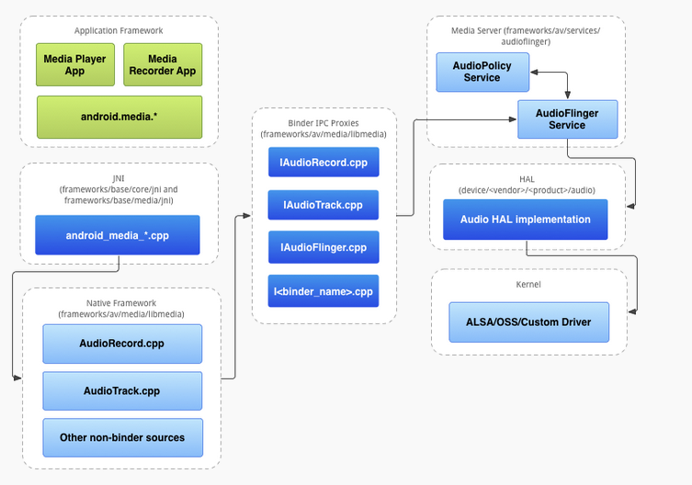
Example of how different layers come into play for audio functionality

Slide 48
Eclipse vs Android Studio
Google has initially used the Eclipse platform to build the development tools for Android app development
Starting May 2013, Google added support for a new IDE called Android Studio built on IntelliJ IDEA platform
In December 2014 Google released Android Studio 1.0

Slide 49
Eclipse vs Android Studio
Learning curve for Android Studio is more steep than an Eclipse based environment
But Google has deprecated Eclipse as a development environment
So Android Studio is the focus of Google
Android Studio is used in this class

Slide 50
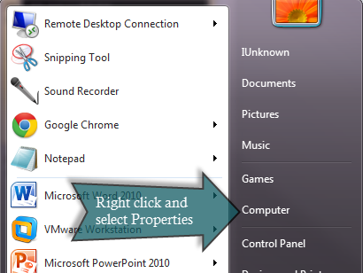
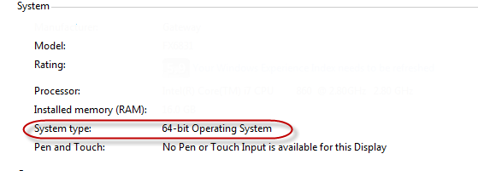
32-bit or 64-bit
Detect which version of OS you are running
On Windows 7, click Start menu, Select Computer and click on Properties
System type indicates 32 bit or 64 bit OS
Based on this information install the specific JDK

Slide 51
JDK Installation
The latest version of tools now only support JDK 1.7
We are using JDK 1.7 in the class
Download JDK 1.7 (32 or 64 bit based on your OS) and install it on your workstation
Set JAVA_HOME to point to the JDK installation. The default location is C:\Program Files\Java\jdk1.7.x
Set OS Path to include %JAVA_HOME%\bin

Slide 52
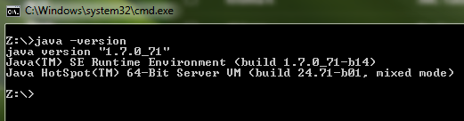
JDK Installation
Open a command prompt and type java –version. You should see the following output
If you get an unrecognized command error, check to see if your PATH includes the bin folder of JDK installation

Slide 53
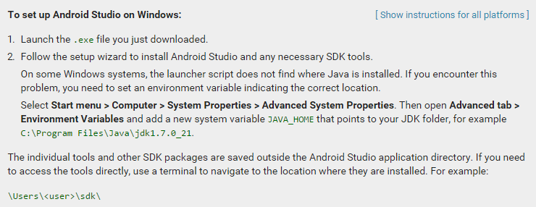
Android Studio Installation

Slide 54
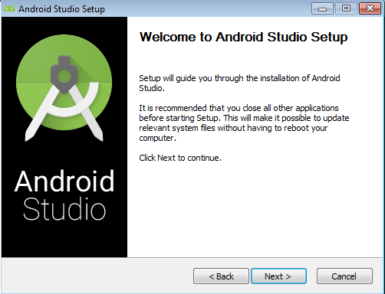
Android Studio Installation

Slide 55
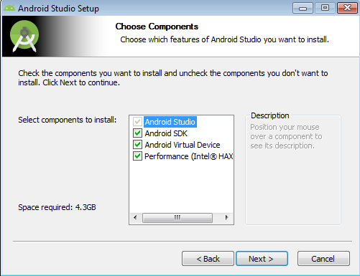
Android Studio Installation

Slide 56
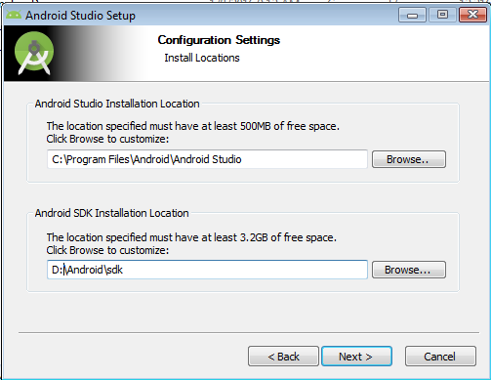
Android Studio Installation

Slide 57
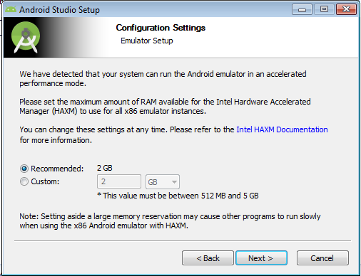
Android Studio Installation

Slide 58
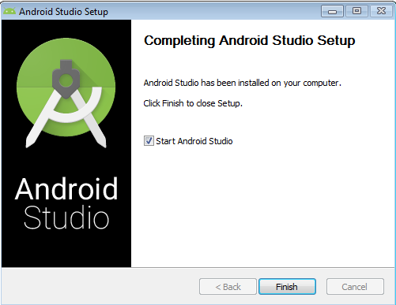
Android Studio Installation

Slide 59
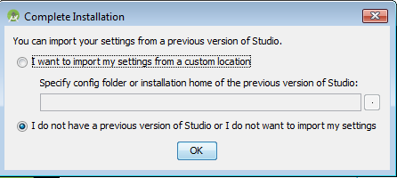
Android Studio Installation

Slide 60
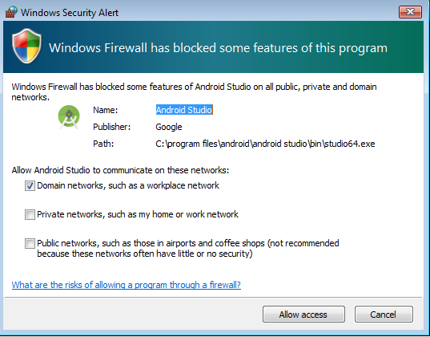
Allow Access to Network

Slide 61
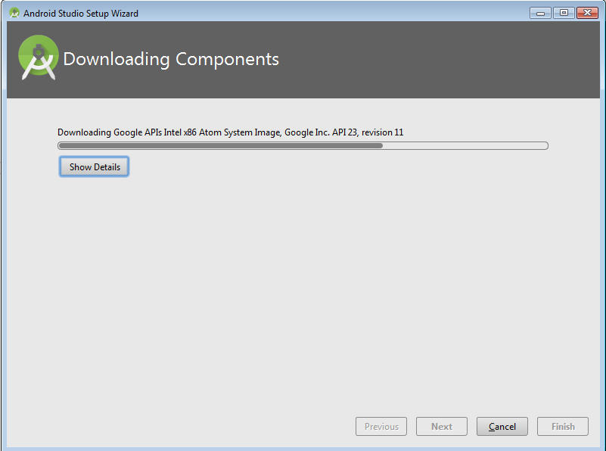
Android Studio Installation

Slide 62
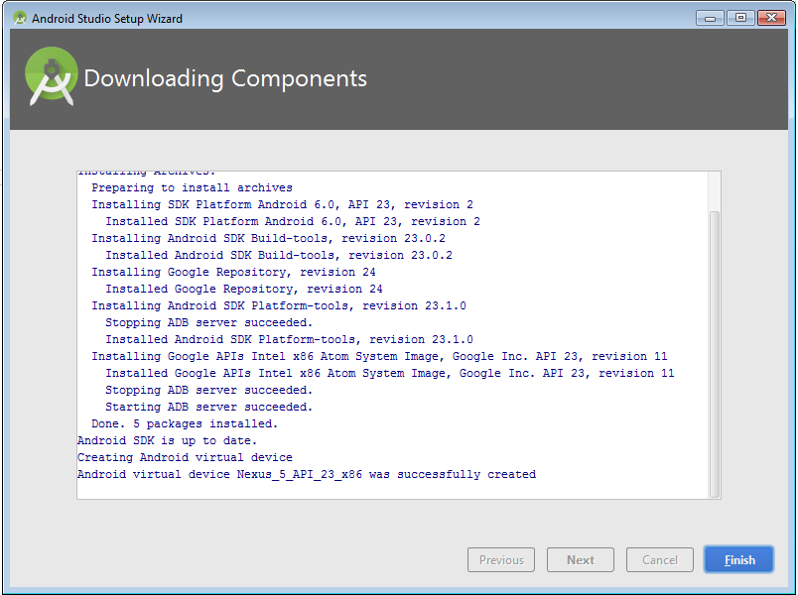
Android Studio Installation

Slide 63
SDK Manager
SDK Manager shows all the SDK packages available to add to the Android SDK
At minimum you should have
Latest Tools packages (check the Tools folder)
Latest version of Android (check the first Android folder)
Android Support Library (in the extras folder) is required for supporting older devices

Slide 64
Launch SDK Manager
Go to the Android SDK folder and launch “SDK Manager.exe”

Slide 65
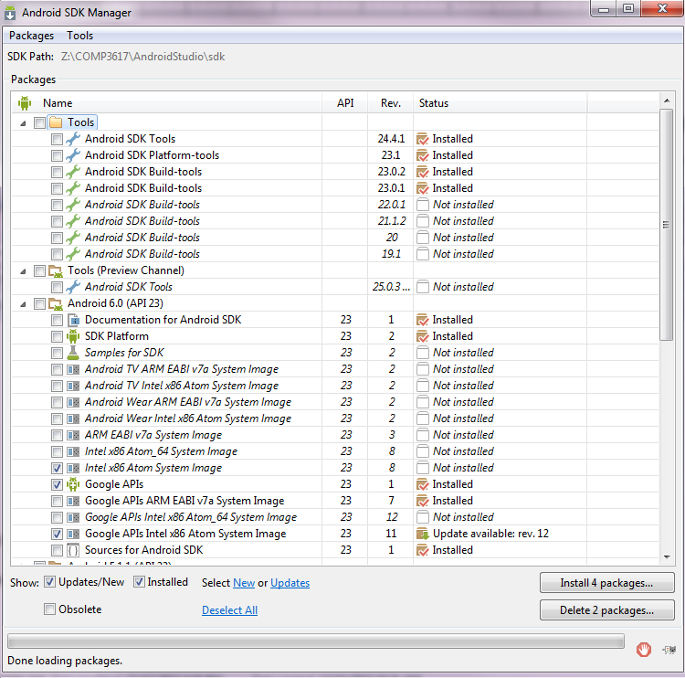
Launch SDK Manager
Make sure Android SDK Tools, Android SDK Platform tools, Android Build tools match the latest versions as shown in the above picture

Slide 66
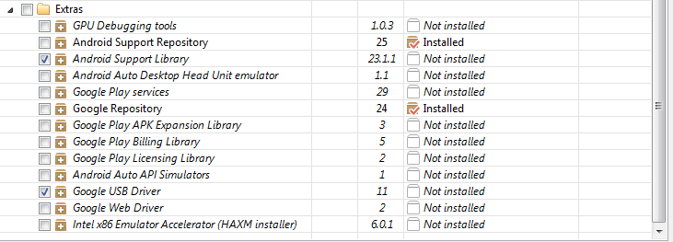
SDK Manager
Make sure Android Support Library is checked and Android USB driver (if working on Windows and you want to use the device)

Slide 67
Additional Steps
Set the PATH environment variable to include
sdk\tools
sdk\platform-tools

Slide 68
AVD (Android Virtual Device)
AVD is an Android Emulator
Android Studio automatically creates an Emulator based Nexus 5 device
You can define your own Emulator based on an existing device profile or provide your own settings
We will do so from Android Studio

Slide 69
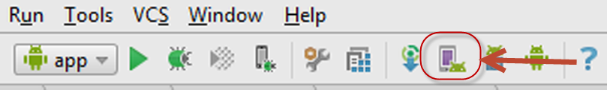
AVD Manager
To bring up the AVD Manager click on the icon show in the toolbar of Android Studio

Slide 70
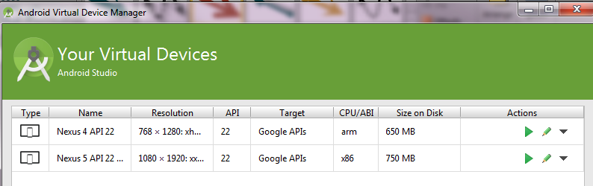
AVD Manager
To create a new Virtual Device, click on the button below called “Create Virtual Image” at the bottom of this screen

Slide 71
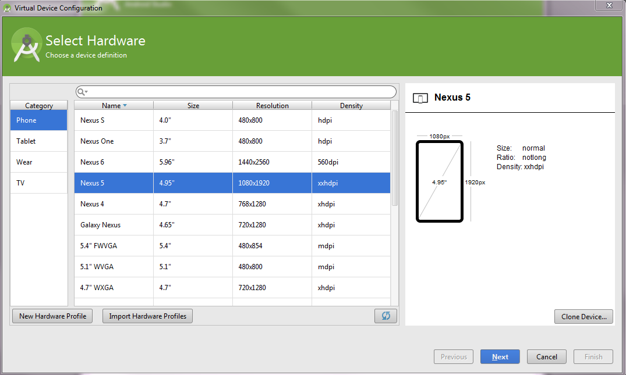
AVD Manager
Select the device based on which you want to create the emulator and click next

Slide 72
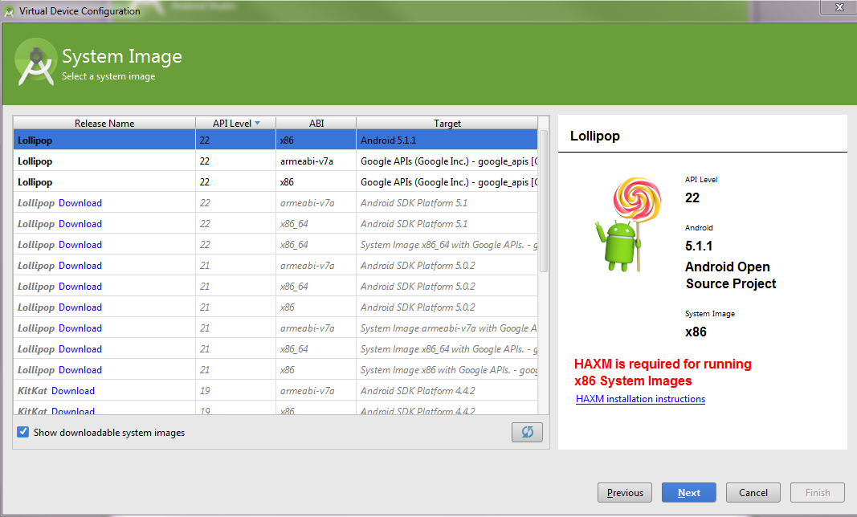
AVD Manager
Select the image based on which you want to create the emulator. Typically it is x86

Slide 73
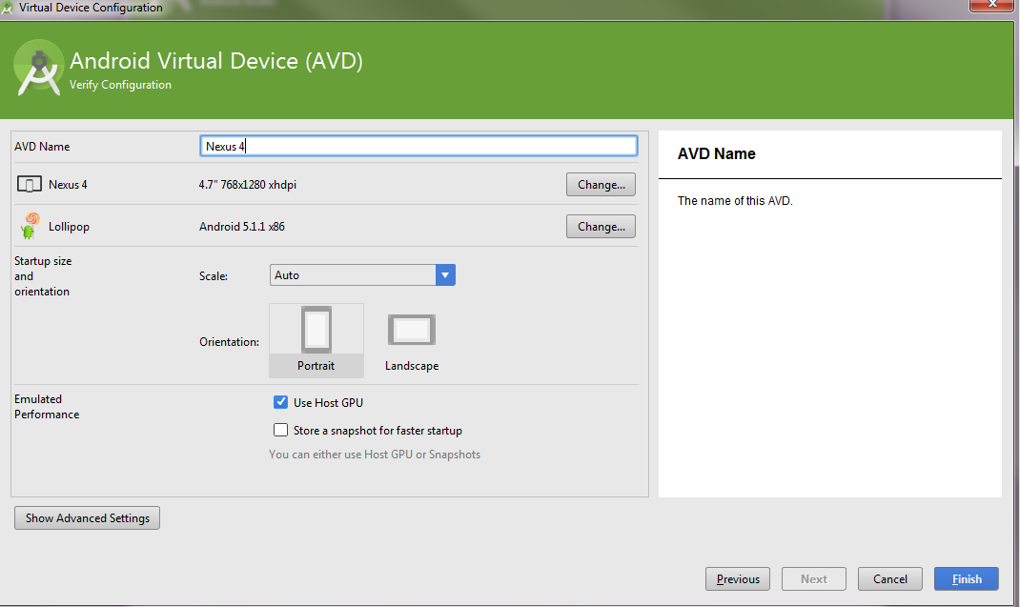
AVD Manager
Select the defaults and click Finish

Slide 74
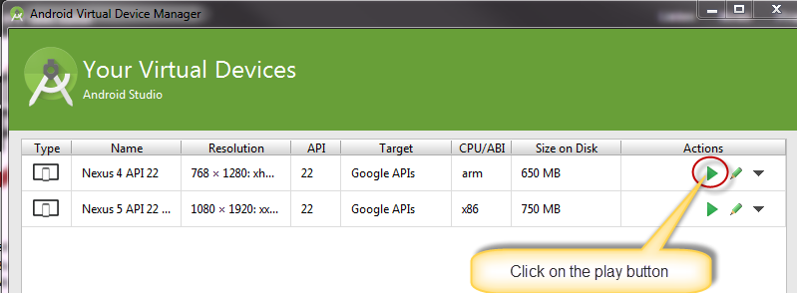
Launching the AVD
Be patient. The first time around it takes 10+ minutes sometimes to set up the image and start it up

Slide 75
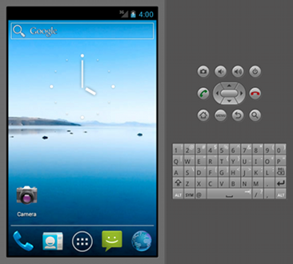
Device Definition and AVD
Device Definition (Characteristics of a device)
Screen characteristics
Physical Key board
Camera characteristics
GPS Characteristics
Your app runs on the AVD

Slide 76
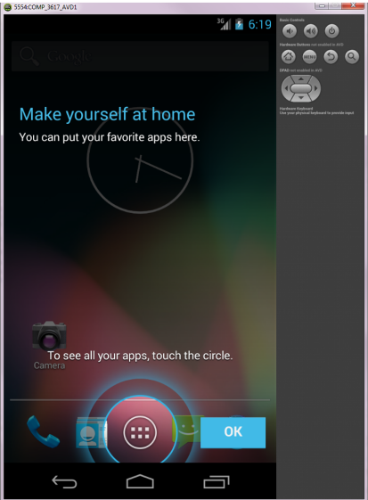
Launch the AVD
After a few minutes (on one of machines it took 5 mins without HAXM), you should see the emulator

Slide 77
Launch AVD
Once you have the AVD running, it should be fast
Leave the AVD running all the time so it does not waste your time
You can start up the AVD as you come into the class so you don’t have to wait for it come up when you need it.

Slide 78
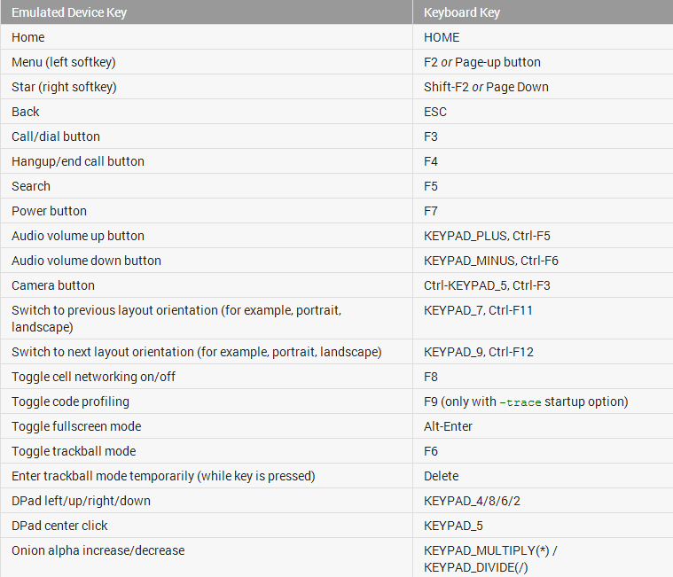
Emulator Keys
Notes:
http://developer.android.com/tools/help/emulator.html#controlling

Slide 79
Emulator Limitations
No support for placing or receiving actual phone calls
No support for bluetooth
No support for USB connections
No support for determining network connected state
No support for determining SD card insert/eject

Slide 80
Intel x86 System Image
Android emulators are painfully slow
Sometimes it takes several minutes (5 – 10) to start up for the first time (subsequent start ups can be faster)
One of the reasons for this is the emulation of ARM based processors in the emulator
Newer releases included an x86 image where allows x86 based host machines to run the emulator faster

Slide 81
Intel x86 System Image
Performance of x86 system image can be further improved with hardware based virtualization using Intel VT-x technology

Slide 82
Intel x64 System Image
Google released a 64bit based emulator image
Have not been able to successfully start it as the issue seems to be related to CPU of the machines in the classroom
Do not use it in the classroom

Slide 83
Intel HAXM
Hardware acceleration manager
Automatically installed when installing Android Studio
Speeds up the emulator
If your host is an old machine, HAXM might not work
More specifically HAXM only works Intel hardware which has Intel VT-x capabilities

Slide 84
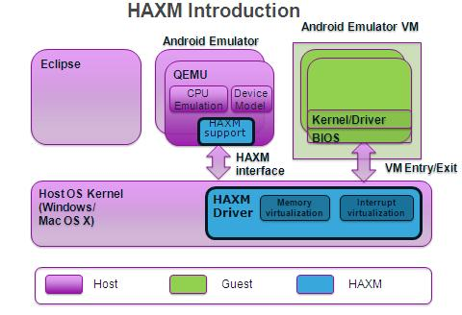
Intel HAXM architecture

Slide 85
Navigating Android SDK
Name | Folder | Description
SDK Tools | <sdk>\tools\ | Tools for debugging and testing. Utilities to develop an app
SDK Platform Tools | <sdk>\platform-tools | Platform dependent tools for developing and debugging an app
SDK Platform | <sdk>\platforms\android-<ver> | Contains android.jar. To build an app, you must specify an SDK platform as the build target
System Images | <sdk>\platforms\android-<ver> | Each platform has one or more system images (ARM or x86). Emulator requires an image to boot up
Extras | <sdk>\extras | Contains Google USB driver, Intel HAXM, Android Support Library and other Google libraries

Slide 86
ADB
Android Debug Bridge – main tool in SDK
Allows the development environment to interact with the emulator or connected device
Allows for pushing or pulling data and apps
Issues shell commands
Reads system logs
Located in platform-tools folder under sdk

Slide 87
ADB
Client Server program to manage Android device and emulator
Contains 3 pieces
Client – Command line tool to be invoked on Dev machine (adb)
Daemon – Runs as a background process on the emulator / device
Server – Runs on the Dev machine in the background.

Slide 88
ADB Architecture
Dev workstation (PC/Mac/Linux)
Device
adbd
adb Daemon
adb
adb Server
Emulator
adb client
(Android Studio or other cmd line)
adbd
adb Daemon

Slide 89
Sample ADB commands
Command | Description
adb devices | List the devices attached including emulator instances
adb –s emulator-5554 cmd | Invoke the common on a specific device (here emulator-5554)
adb push C:\temp\song.mp3 /sdcard | Copies file to the device from host machine
adb pull /sdcard/song.mp3 C:\Temp | Copies file from the device to the host machine
adb shell | Opens a linux shell to the device where you can run unix commands like ls, rm etc. To leave the shell press Cntrl + D
adb install myapp.apk | Installs an application from the host on to the device
adb uninstall com.comp3617.week1.demo1 | Uninstalls the app identified by package name
adb kill-server | Stops the adb process
adb start-server | Restarts the adb process

Slide 90
Resetting ADB server
Sometimes ADB loses connectivity and would require resetting the process
Invoke the following commands in order
adb kill-server
adb start-server

Slide 91
Setting up a Device – Not required for the course
Make the device ready for development
Different versions of Android have different setup instructions
Enable USB debugging
Settings → Developer Options (4.0)
Stay Awake turned on so the device stays awake while plugged into USB
Driver – For Windows you have two options
Google provided driver (for Android Developer Phones) or Manufacturer-supplied one
For Mac and Linux, no drivers are required
Notes:
Check out details here http://developer.android.com/tools/device.html#setting-up
OEM USB drivers http://developer.android.com/tools/extras/oem-usb.html
For devices < android 4.0
Settings → Applications →Debugging
For devices > Android 4.2
Settings → About Phone. Tap “Build Number” 7 times and then the Settings -> Developer Options shows up

Slide 92
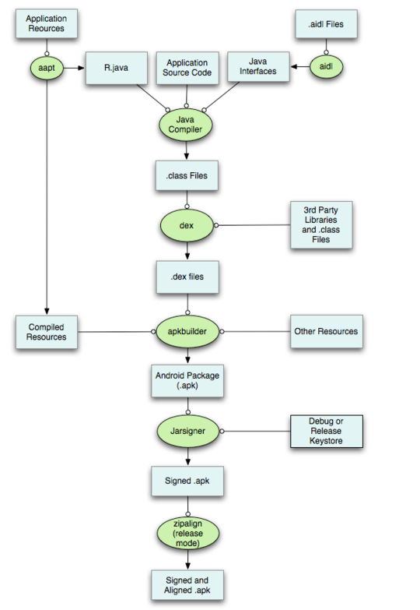
Android Build

Slide 93
Android Resources
http://developer.android.com/develop/index.html
API Guide http://developer.android.com/guide/components/index.html
Reference http://developer.android.com/reference/packages.html
Tools http://developer.android.com/tools/index.html
Design http://developer.android.com/design/index.html
Notes:
Google tends to update the Android site frequently, so any of the above links fail – go to http://developer.android.com and you can navigate from there

